Slide 1
Report on Amazon Sales Analysis
Prepared by Shakil Ahammed

Slide 2

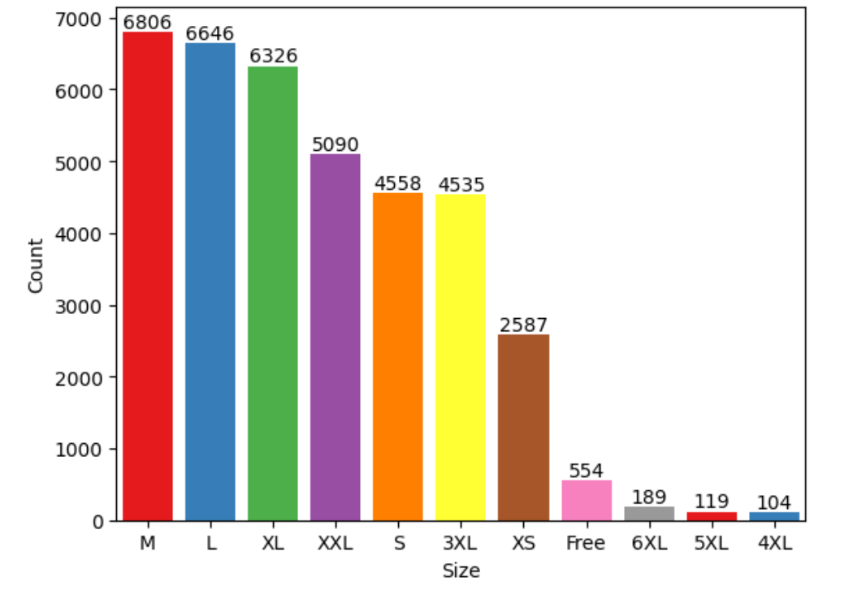
Most of the people buys M-Size.

Slide 3
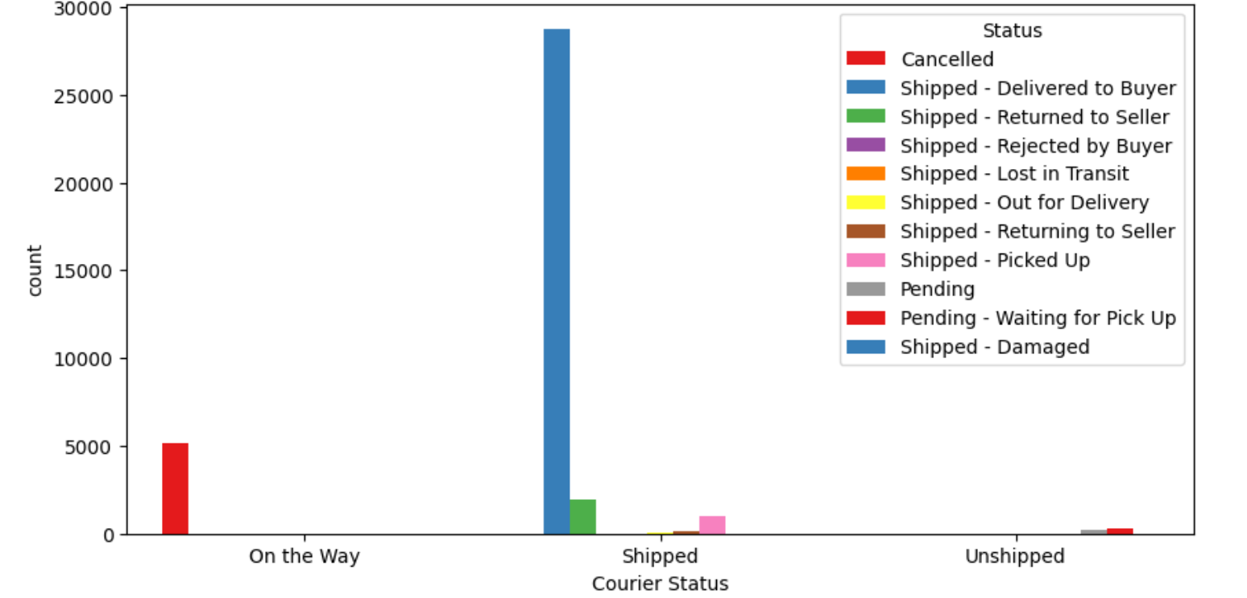
The majority of the orders are shipped through the courier.

Slide 4
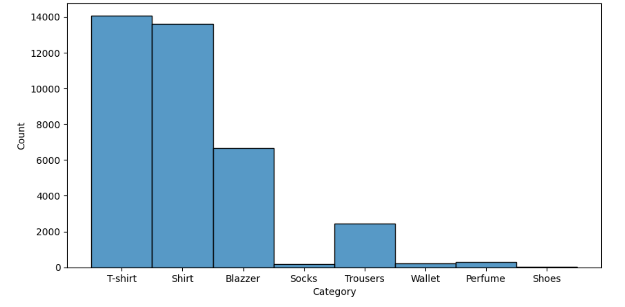
Most of the buyers buy T-shirt.

Slide 5
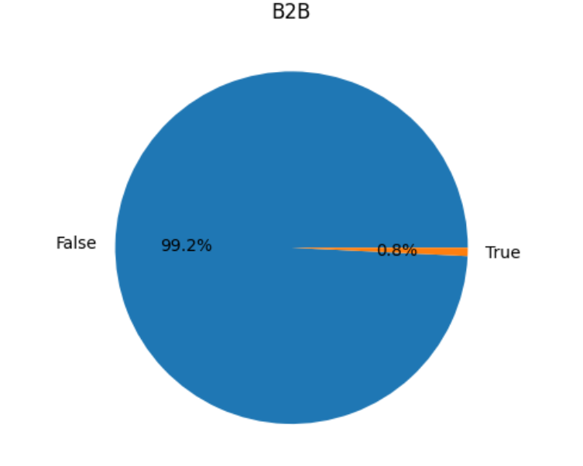
Maximum i.e. 99.2% of buyers are retailers and 0.8% are B2B buyers.

Slide 6
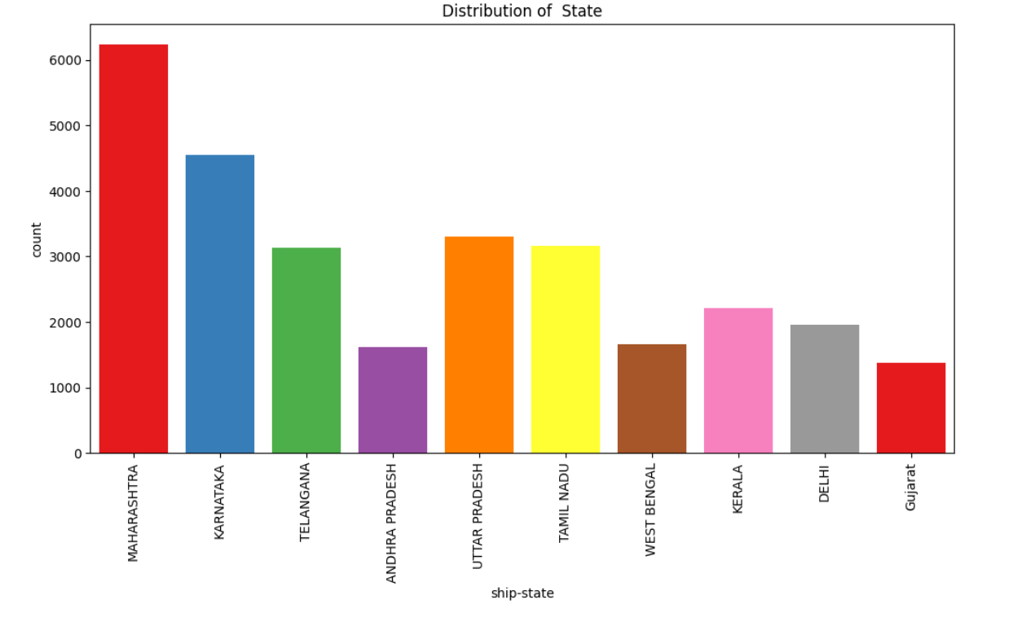
Most of the buyers are from Maharashtra state.

Slide 7
Conclusion
The data analysis reveals that the business has a significant customer base in Maharashtra state, mainly serves retailers, fulfills orders through Amazon, experiences high demand for T-shirts, and sees M-Size as the preferred choice among buyers.

Slide 8
Recommendation
1. Targeted Marketing Campaigns.
2. Regional Customization.
3. Online Presence Enhancement.
4. Customer Feedback and Engagement.

